Slide 1
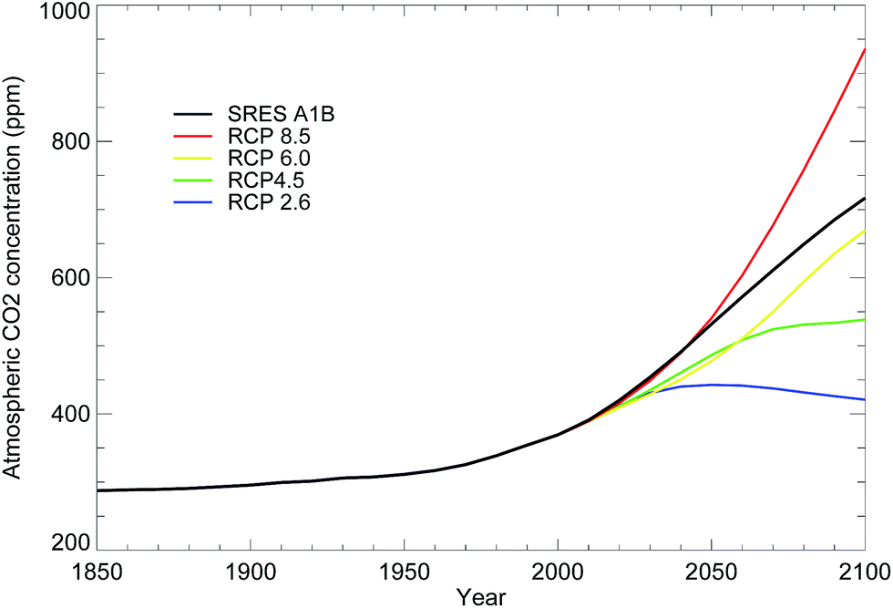
ACCESS-ESM: Vision, needs and challenges for Australia Andrew Lenton + ACCESS-ESM Team

Slide 2
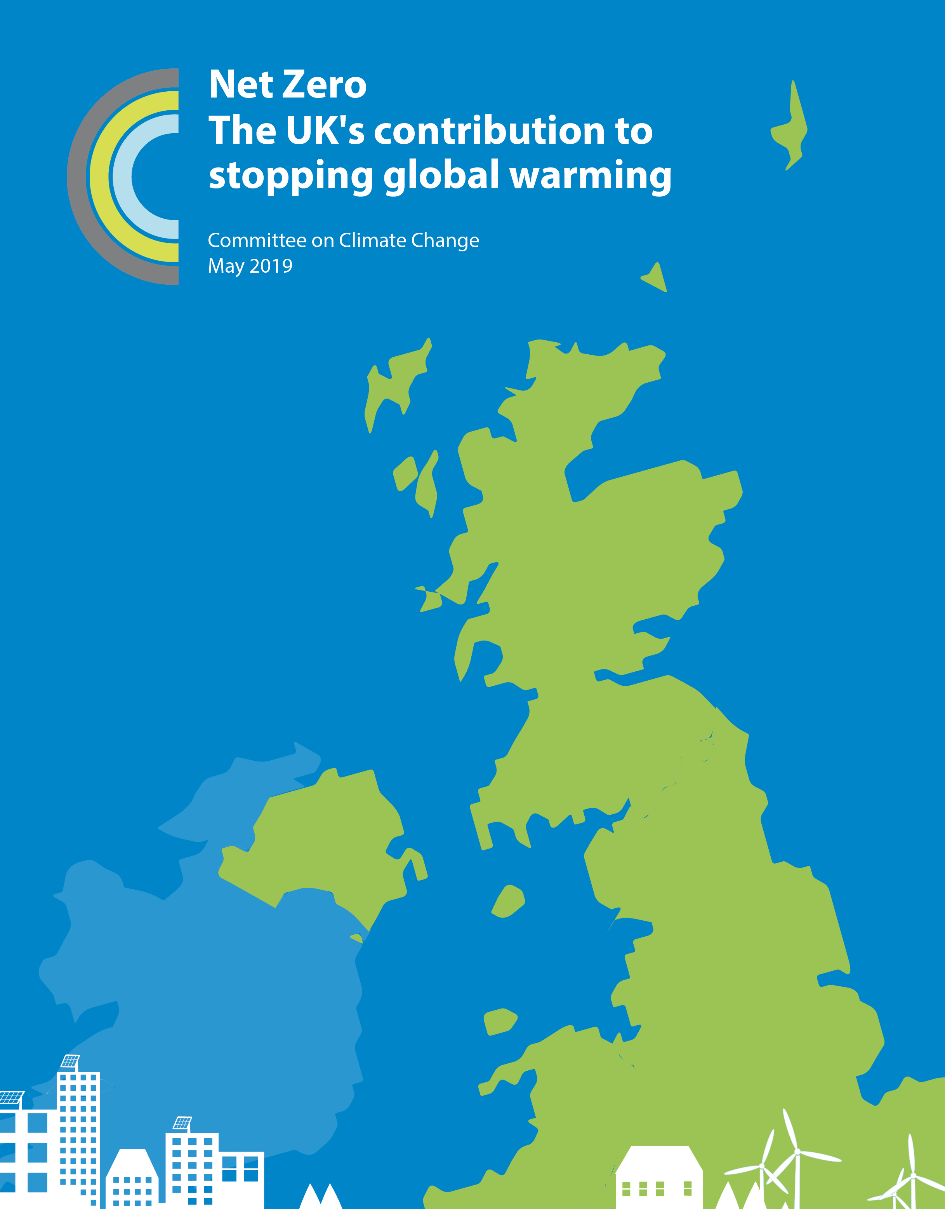

Climate changes impact on climate and ecosystem services
ANO3
Across - O&A and A&F
Universities and ARC
Link to projections in the Pacific (GCF)
Negative Emissions work
Discussions with Govt Departments and private sector

Slide 3
Bio-physical and socio-economic coupling +IAM
GTEM-C
Biophysical Model
Households:
Demand goods and services Supply factor inputs
Anthropogenic GHG emissions
Policy
Atmosphere
Factor inputs
Factor inputs
Government
Final goods & services
Agricultural endowment & working environment
Land and amenities
Firms:
Demand factor inputs Supply (final) goods and services
Policy
Heating, power, mobility
Fossil fuels and alternative energy sources
Intermediate goods and services
Socioeconomic system
Biophysical system
Key to transition to low carbon pathways and assessing the implications of these

Slide 4
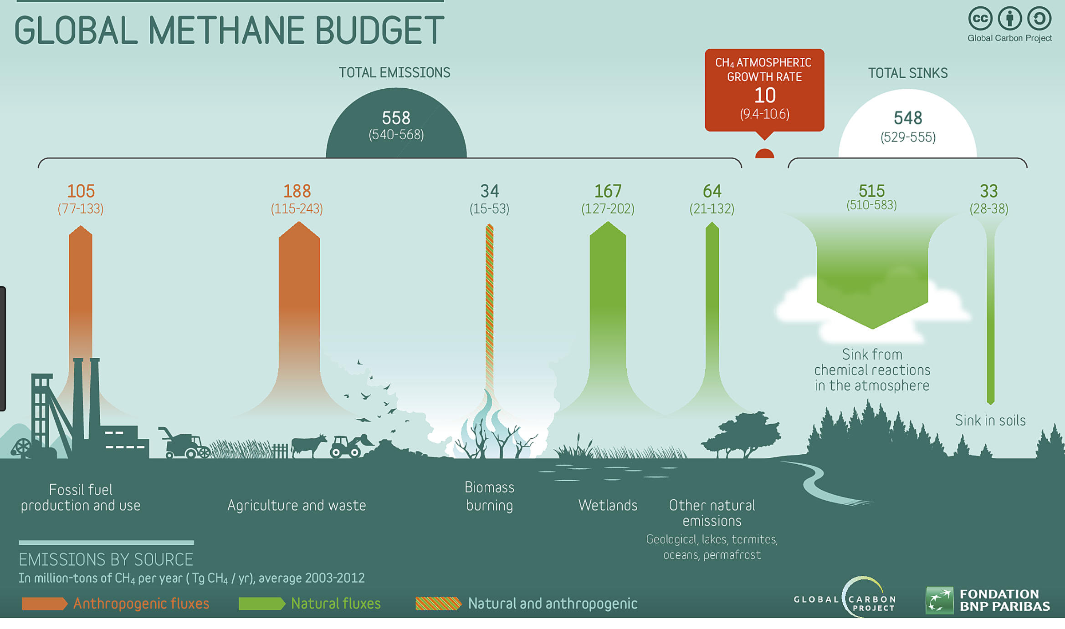
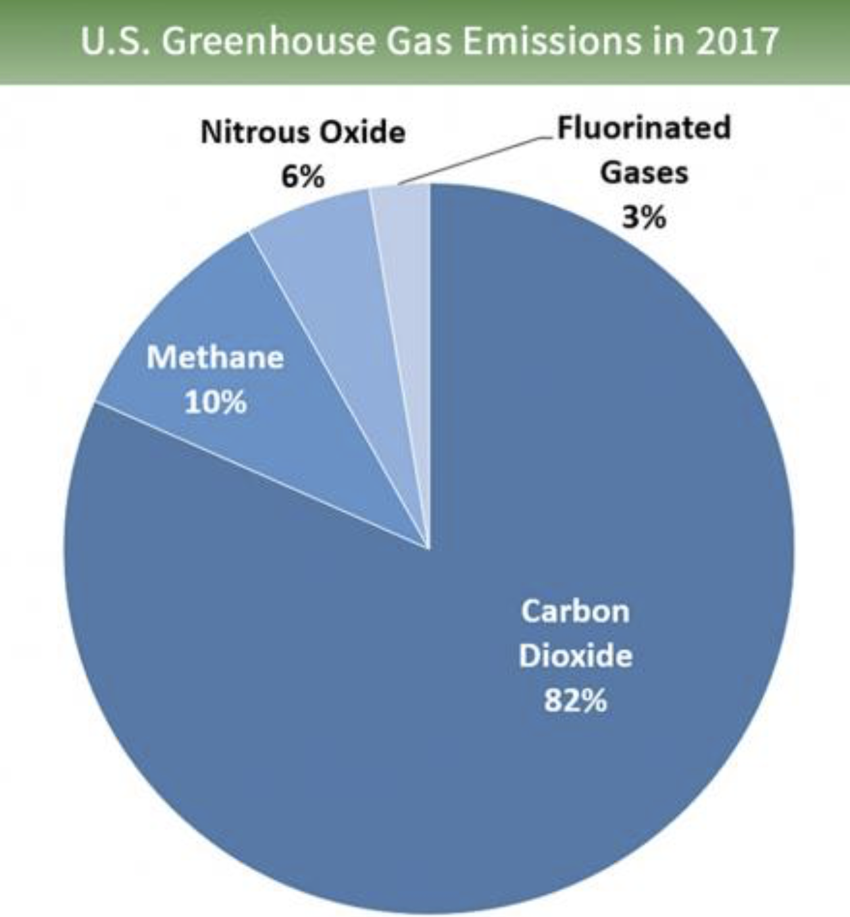
Non-CO₂ Greenhouse Gases
Significant Advances in non-CO₂ GHGs
Inclusion of CH₄ and N₂O
Allows to explore relationships under different pathways
Key to low emissions pathways
Linked to observational efforts e.g. GCP
Feedbacks

Slide 5
Strong value proposition
Pay for science not necessarily development
Person Power < 1 FTE @ present
Storage and compute
Sustained Funding – CMIP5 was successful and lead to reduced funding
Sustaining multiple modelling systems – resolutions?
Need to deliver the science impact – time?
Notes:
It has been in quasi-equilibrium, sitting around 280 ppm

